Slide 1
Linux Kernel Backdoors
And Their Detection
Joanna Rutkowska
joanna@invisiblethings.org
ITUnderground Conference,
October 12th -13th 2004, Warsaw

Slide 2
Goals
Provide some details about network kernel subsystem in modern Linux kernels,
Show potential techniques for implementing hard to detect network backdoors and covert channels,
Discuss possible approaches for detection of such malware.

Slide 3
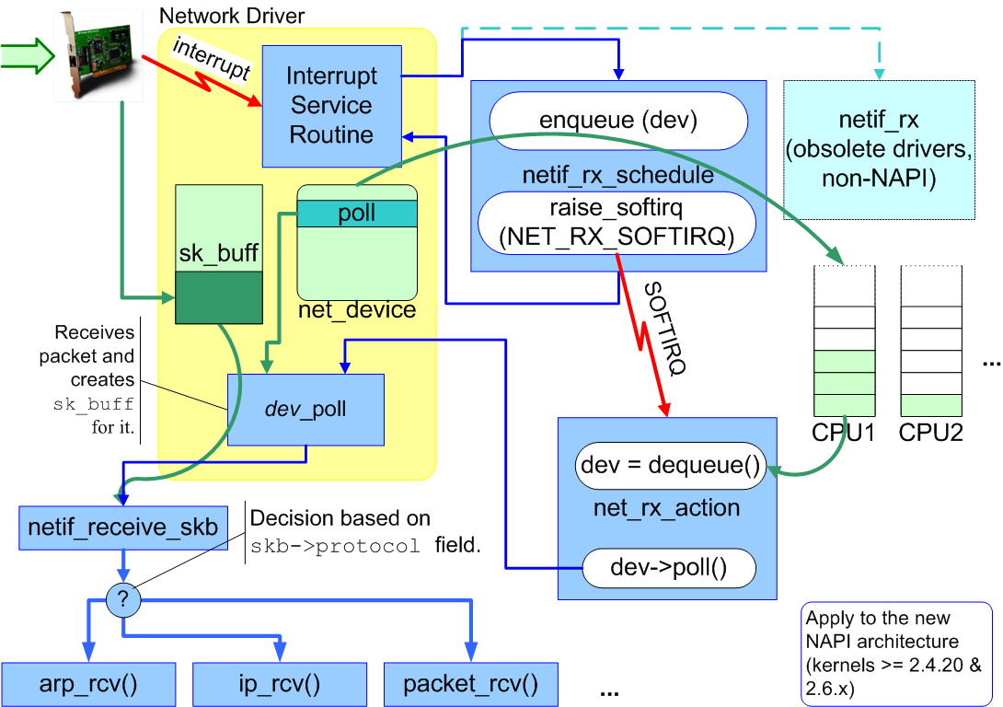
Network Packets Handling (1)

Slide 4
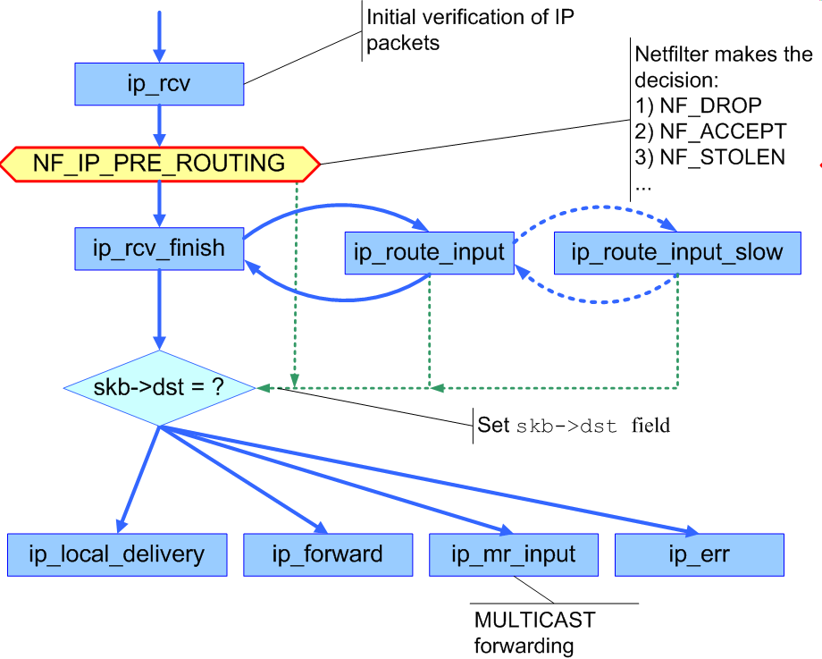
Network Packets Handling (2)

Slide 5
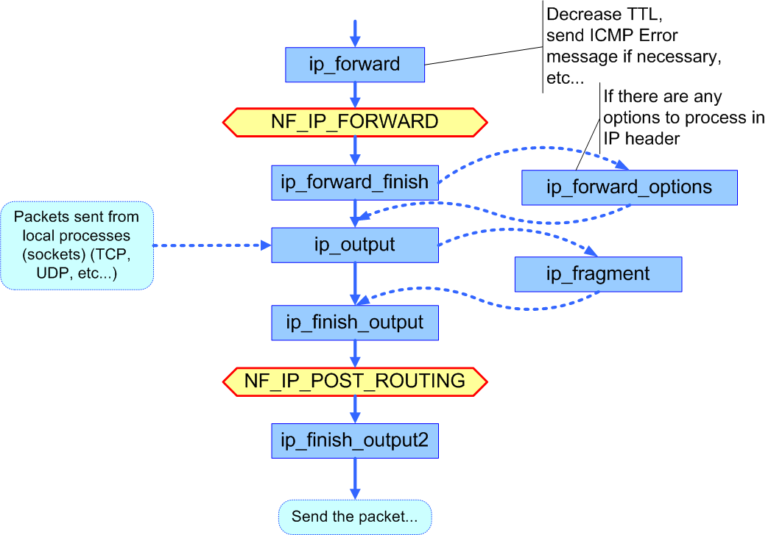
Network Packets Handling (3)

Slide 6
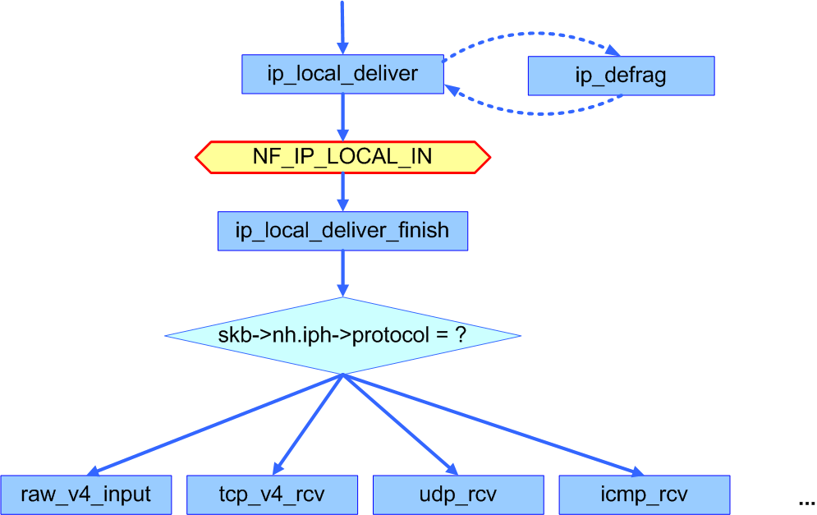
Network Packets Handling (4)

Slide 7
Two important techniques
ptype_* handlers
Add new protocol handler, which could simply recognize magic packets (SADoor-like) or modify packets’ contents on the fly (passive covert channels)
Netfilter hooks
Add new NF hook, which could basically do the same things as ptype handler. Also it could circumvent local firewall (since ipfilter is also implemented using NF hooks).

Slide 8
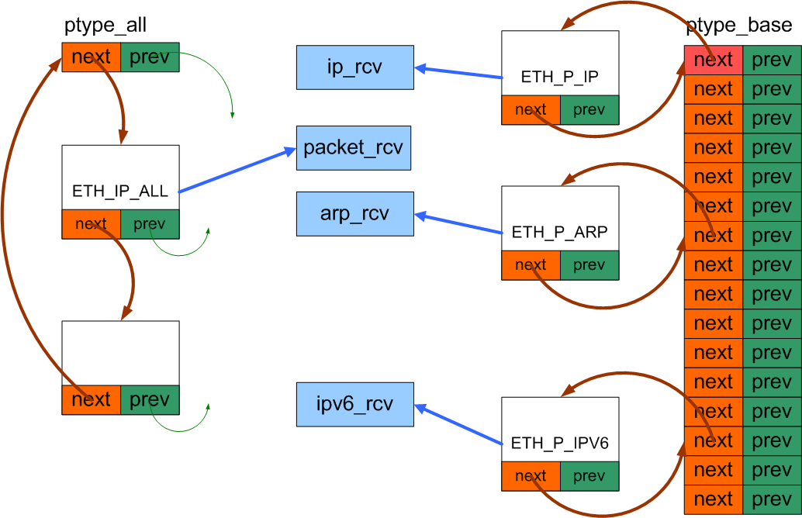
protocol handlers

Slide 9
Key structure: packet_type
struct packet_type
{
unsigned short type; ← htons(ether_type)
struct net_device *dev; ← NULL means all dev
int (*func) (...); ← handler address
void *data; ← private data
struct list_head list;
};
There are two exported kernel functions for adding and removing handlers:
void dev_add_pack(struct packet_type *pt)
void dev_remove_pack(struct packet_type *pt)

Slide 10
Addition of own handler
struct packet_type myproto;
myproto.type = htons(ETH_P_ALL);
myproto.func = myfunc;
myproto.dev = NULL;
myproto.data = NULL;
dev_add_pack (&myproto)

Slide 11
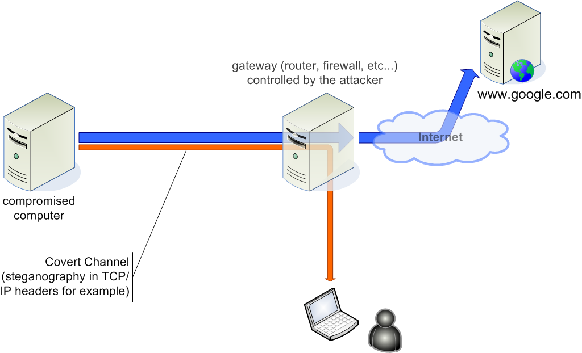
Passive Covert Channel Example

Slide 12
IP Header and simple CC
Simple CC
(1 byte per packet)
0
3 4
7 8
15 16
31
version
hdr len
TOS
total length
id
flags
fragment offset
TTL
protocol
checksum
source address
destination address

Slide 13
DEMO: simple passive CC in IPID
secret message: ABABA
10.0.0.2 > 172.16.0.2: [|tcp] (DF) [tos 0x10] (ttl 64, id 16640, len 100)
4510 0064 4100 4000 4006 4370 0a00 0002
ac10 0002
10.0.0.2 > 172.16.0.2: [|tcp] (DF) [tos 0x10] (ttl 64, id 16896, len 52)
4510 0034 4200 4000 4006 42a0 0a00 0002
ac10 0002
10.0.0.2 > 172.16.0.2: [|tcp] (DF) [tos 0x10] (ttl 64, id 16640, len 52)
4510 0034 4100 4000 4006 43a0 0a00 0002
ac10 0002
10.0.0.2 > 172.16.0.2: [|tcp] (DF) [tos 0x10] (ttl 64, id 16896, len 100)
4510 0064 4200 4000 4006 4270 0a00 0002
ac10 0002
10.0.0.2 > 172.16.0.2: [|tcp] (DF) [tos 0x10] (ttl 64, id 16640, len 52)
4510 0034 4100 4000 4006 43a0 0a00 0002
ac10 0002

Slide 14
What is interesting in this simple CC?
Kernel implementation (as ptype handler)
There is no (easy) way to check what protocol handlers are registered in the kernel(!)
Seems like it is hard to detect that we have something like this in our kernel.
Of course you can detect this simple CC by network traffic analysis
We can imagine more complex CC implemented this way…

Slide 15
Simple places to hide information in HTTP protocol
GET http://www.somehost.com/cgi-bin/board.cgi?view=12121111 / HTTP/1.0
Host: www.somehost.com
User-Agent: Mozilla/5.0 (12121111)
Accept: text/html
Accept-Language: en,fr,en,fr,en,en,en,en
Accept-Encoding: gzip,deflate,compress
Accept-Charset: ISO-8859-1,utf-8,ISO-1212-1
CONNECTION: close
Proxy-Connection: close
X-Microsoft-Plugin: unexpected error #12121111
source: http://gray-world.net

Slide 16
Digression about more interesting covert channels
TCP Timestamps: information hidden in least significant bit of TCP timestamp(!)
TCP ISN modulation. Note: unlike most current implementations, when considering passive ISN CC, the handler routine must track the whole TCP connection and change all the sequential numbers in all packets of that connection. It is necessary so that the user will not notice anything suspicious in her connection.
???
All of the above ideas could be implemented as a passive channels using ptype handlers.

Slide 17
TCP Timestamp Covert Channel
Idea and the simple implementation:
  John Giffin i inni, Covert Messaging Through TCP Timestamps, Massachusetts Institute of Technology, 2002.
  http://www.mit.edu/~gif/covert-channel/.
Information hidden in LSB of TCP timestamp. Not as easy as it may sound – watch out for turning back in time!
Secret shared by the two peers – without the secret it should be impossible to even find out that the communication occur (although the algorithm is known) – seems like real CC, based on theory and not on a “secret concept”.

Slide 18
How to detect?
How to get a list of registered protocol handlers?
Author does not know any tool (or even kernel API) for doing that!
We need to “manually” check the following lists:
  ptype_all
  ptype_base
But their addresses are not exported!

Slide 19
Where are the protocol lists?
Two kernel global variables (net/core/dev.c):
  static struct packet_type *ptype_base[16];
  static struct packet_type *ptype_all = NULL;
Only the following functions are referencing those variables (i.e. “know” their addresses):
Kernel 2.4.20 | Kernel 2.6.7
dev_add_pack() dev_remove_pack() dev_queue_xmit_nit() netif_receive_skb() | dev_add_pack() __dev_remove_pack() dev_queue_xmit_nit() netif_receive_skb() net_dev_init()
The functions in green are exported.

Slide 20
Approaches for finding the lists
System.map file
  problem: the file is not always up to date or sometimes it does not even exist (for security reasons;))
“heuristic” method
  We know the addresses of several functions which are using the addresses we are looking for.
  We can look at their body to find all the 32 bit words which looks like kernel pointers.
  Then we need to find the common set of those pointer-like words from all functions we consider.
  At last we need to check every potential value from the common subset to see if it looks like (or could be) ptype_all or ptype_base list head.

Slide 21
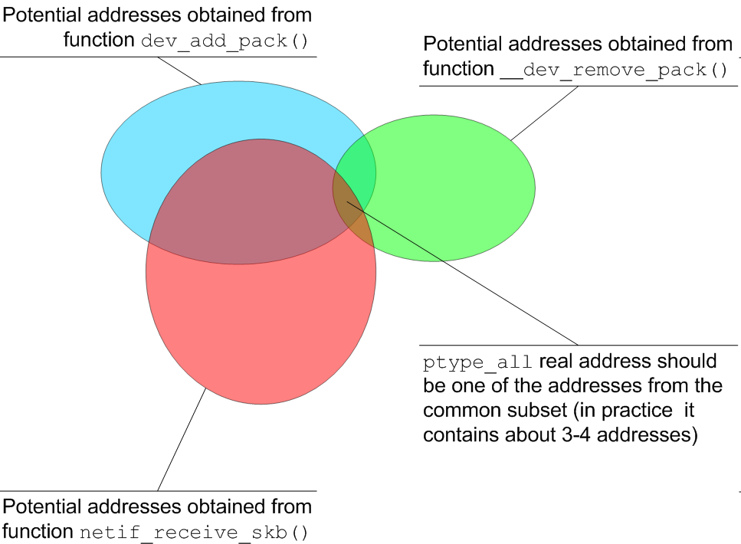
Illustration for heuristic method

Slide 22
Live DEMO: detecting additional protocol handlers
PTYPE_ALL:
hook type ETH_P_ALL (0x3)
hook at: 0xc487e060 [module: unknown module]
PTYPE_BASE[]:
hook type ETH_P_IP (0x800)
hook at: 0xc0203434 -> ip_rcv() [k_core]
hook type ETH_P_802_2 (0x4)
hook at: 0xc01f8050 [k_core]
hook type ETH_P_ARP (0x806)
hook at: 0xc0223778 -> arp_rcv() [k_core]

Slide 23
Lets now talk about Netfilter hooks…
Another way of implementing smart backdoors or CCs in kernel is to register NF hook.
We’ve seen already some NF hooks on the network map.
What is Netfilter exactly?

Slide 24
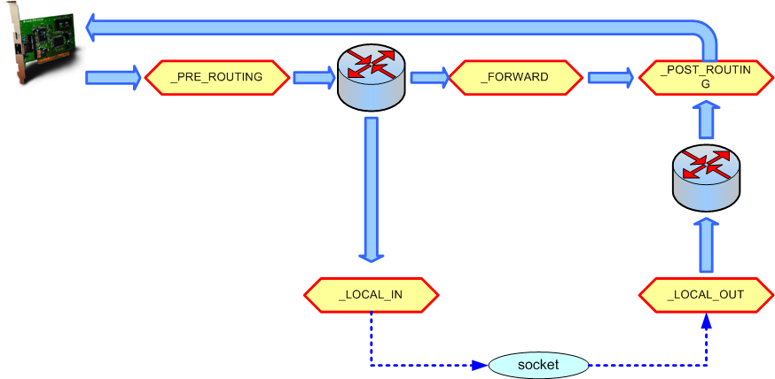
NF HOOKS

Slide 25
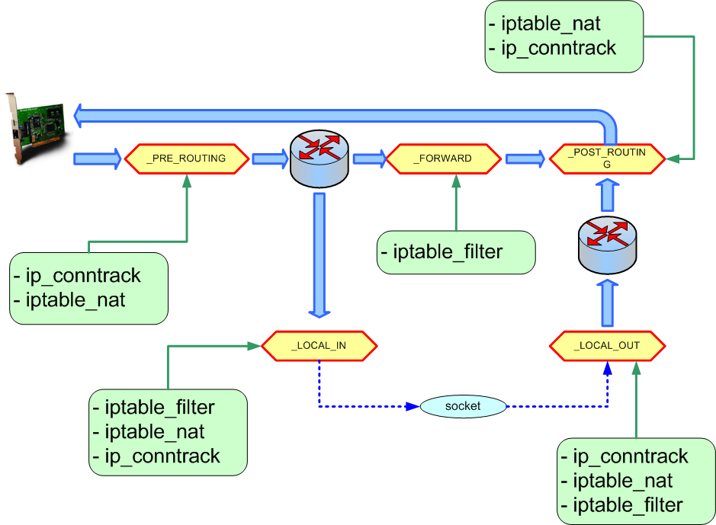
NF HOOKS: ipfilters implementation

Slide 26
Key structure: nf_hook_ops
struct nf_hook_ops
{
struct list_head list;
nf_hookfn *hook; ← handler address
int pf; ← family (AF_INET, AF_INET6, AF_IPX, ...)
int hooknum; ← (NF_IP_*, NF_IP6_*, NF_IPX_*, ...)
int priority;
};
There are two exported kernel functions for adding and removing handlers:
int nf_register_hook(struct nf_hook_ops *reg);
void nf_unregister_hook(struct nf_hook_ops *reg);

Slide 27
Adding new NF hook
myhook.hook = myhandler;
myhook.pf = PF_INET;
myhook.priority = NF_IP_PRI_FIRST;
myhook.hooknum = NF_IP_POST_ROUTING;
nf_register_hook(&myhook);

Slide 28
Registered NF hooks lists
struct list_head
nf_hooks[NPROTO][NF_MAX_HOOKS];
AF_UNSPEC (0)
AF_UNIX (1)
AF_INET (2)
AF_AX25 (3)
AF_IPX (4)
AF_APPLETALK(5)
NF_IP_PRE_ROUTING (0)
NF_IP_LOCAL_IN (1)
NF_IP_FORWARD (2)
NF_IP_LOCAL_OUT (3)
NF_IP_POST_ROUTING(4)

Slide 29
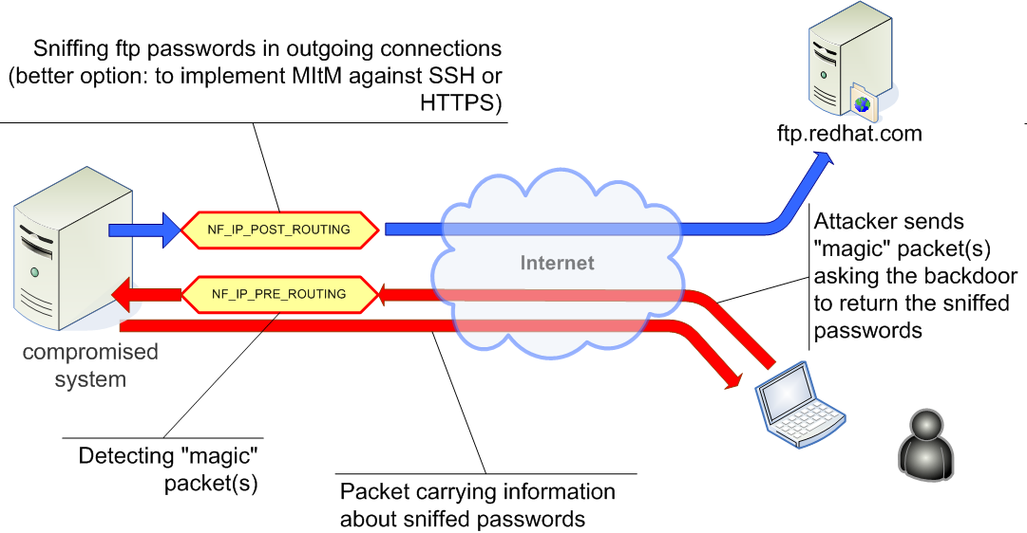
Simple example
implementation: bioforge, Hacking the Linux Kernel Network Stack, Phrack Magazine, Issue 61.

Slide 30
How to detect?
Fortunately nf_hooks address is exported by all kernels (known to the author) :)
Knowing the address of nf_hooks we just need to scan all the hook lists and find the suspicious hooks.
Suspicious are for example the ones, which do not belong to any modules address space (since the modules have been hidden or removed by the attacker or the code has been injected through /dev/(k)mem)

Slide 31
Live DEMO: Enumerating Netfilter hooks
-- NETFILTER hooks ---
INET NF_IP_PRE_ROUTING hooks:
hook at: 0xc48583ca [module: unknown module]
INET NF_IP_LOCAL_IN hooks:
hook at: 0xc4854060 [module: iptable_filter]
INET NF_IP_FORWARD hooks:
hook at: 0xc4854060 [module: iptable_filter]
INET NF_IP_LOCAL_OUT hooks:
hook at: 0xc485409c [module: iptable_filter]
INET NF_IP_POST_ROUTING hooks:
hook at: 0xc485834a [module: unknown module]

Slide 32
NF Hooks vs. ptype handlers
Both techniques allows attacker to implement kernel backdoors quite easily
It is much harder to detect backdoors implemented as ptype handlers then NF hooks – we need heuristics to find ptype lists (as it was showed)
NF Hooks on the other hand have got some potential advantages of bypassing local IP filters.

Slide 33
Other techniques for implementing backdoors
Raw sockets
  AF_PACKET (used also by tcpdump)
  AF_INET RAWIP (used also by ping)
(Raw) socket can be created by
  usermode process → we need to hide process & socket
  kernel code → we need to hide socket
Socket hiding against: proc/net/raw, /proc/net/packet
Passive CC cannot be implemented using (raw) sockets.

Slide 34
References
Linux Kernel Sources, http://kernel.org
Netfilter Official Documentation, http://netfilter.org
kossak, Building Into The Linux Network Layer, Phrack Magazine, Issue 55, http://phrack.org
bioforge, Hacking the Linux Kernel Network Stack, Phrack Magazine, Issue 61, http://phrack.org
Craig H. Rowland, Covert Channels in the TCP/IP Protocol Suite, First Monday, 1996, http://www.firstmonday.dk/issues/issue2_5/rowland/.
John Giffin i inni, Covert Messaging Through TCP Timestamps, Massachusetts Institute of Technology, 2002.
John Giffin, prosty program implementujący ukryty kanał w znacznikach czasowych TCP, http://www.mit.edu/~gif/covert-channel/.
Andrew Hintz, Covert Channels in TCP and IP Headers, 2003, http://guh.nu/projects/cc/covertchan.ppt.

Slide 35
The End

